Slide 1
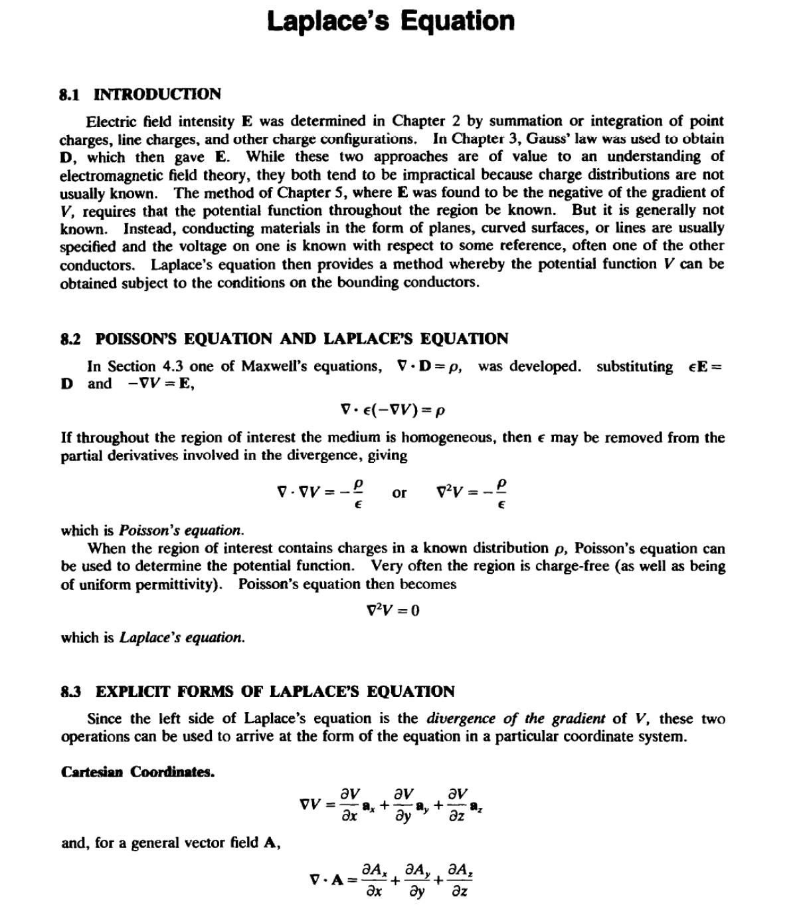
LECTURE EIGHT

Slide 2
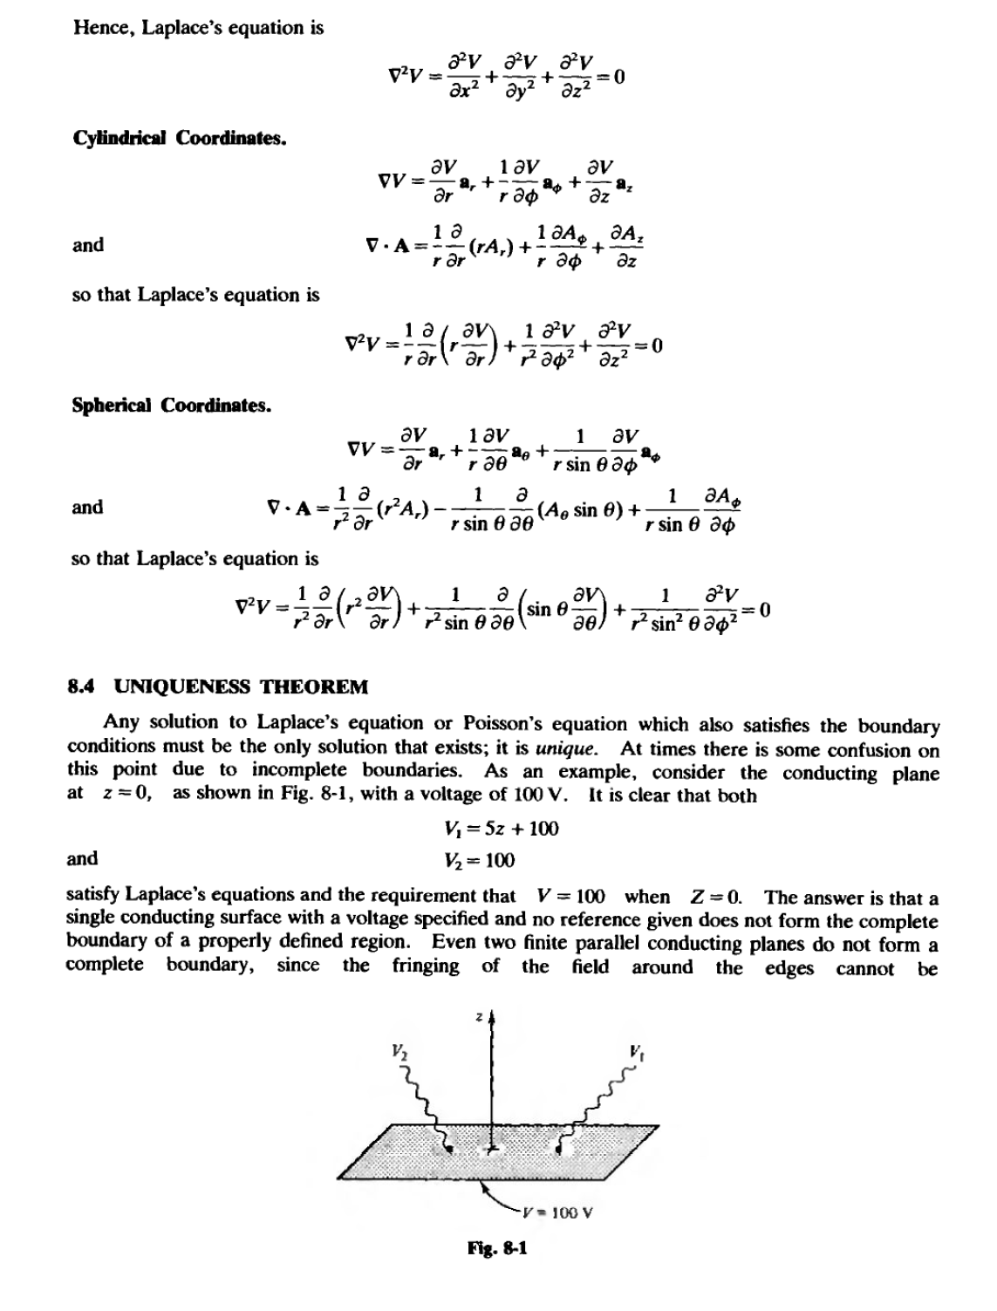
LECTURE EIGHT

Slide 3
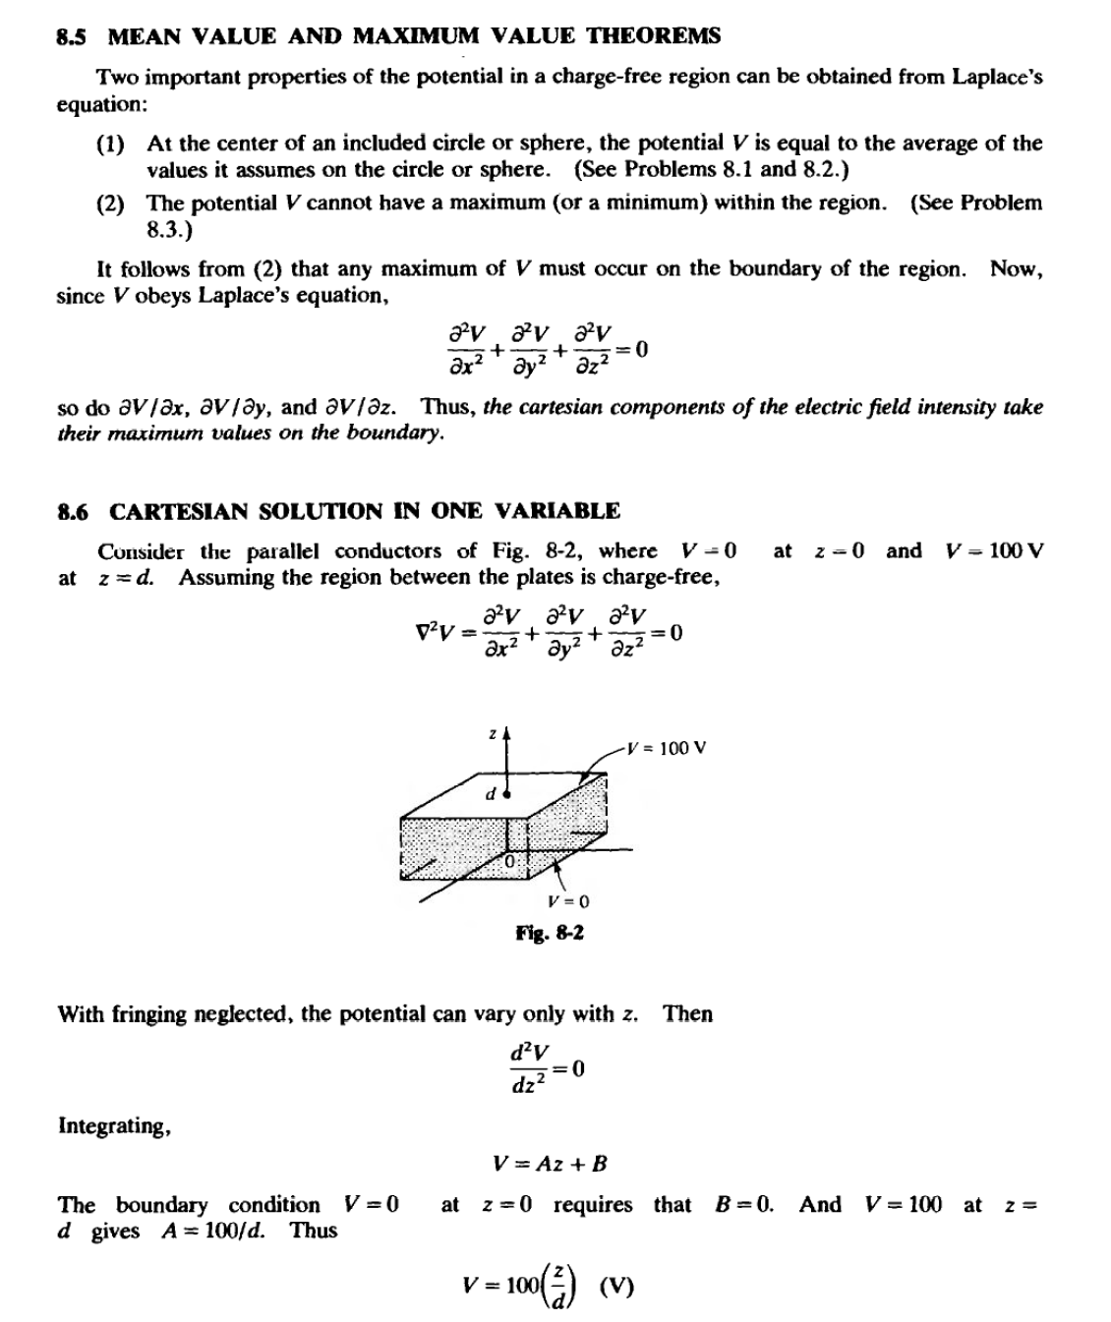
LECTURE EIGHT

Slide 4
LECTURE EIGHT
The electric field intensity E can now be obtained from
E= -vv = _ ( _{ax}v• + a_{oy}va,.+ a_{oz}v•)= _ !_{o}._{z}.(too!)• =_ too• (V/m)
1C
z
d z d z
Then
At the conductors,
where the plus sign applies at z = d and the minus at z = 0.
8.7 CARTESIAN PRODUCT SOLUTION
When the potential in cartesian coordinates varies in more that one direction, Laplace's equation will contain more than one term. Suppose that Vis a function of both x andy. and has the special
rorm V = X(x)Y(y). This will make possible the separation of the variables.
cf(XY) + (XY) =0
ox¹ oy¹
becomes
Since the first term is independent of y , and the second of x, each may be set equal to a constant .
However the constant for one must be the negative of that for the other . Let the constant be a²•
1d²X 1d² Y
--=a2
--= -az
Y dy²
X dx²
llle general solution for X (for a given a) is
X= A,eu + A₂e-IJJC
)r, equivalently,
X= A₃ cosh ax +A₄ sinh ax
md the general solution for Y (for a given a) is
y = B,ef<>r + B2e-it>r
)r, equivalently ,
Y = B₃ cosay + 8₄ sin ay
fherefore, the potential function in the variables x and y can be written
V = (A,e.... + A₂e-....)(B,e"'"+ B,e-lor)
>r
V = (A₃ cosh ax+ A₄ sinh ax)(B₃ cosay +8₄ sin ay)
Because Laplace's equation is a linear, homogeneous equation, a sum of products of the above
orm-each product corresponding to a different value of a-is also a solution . The most general
:olution can be generated in this fashion .

Slide 5
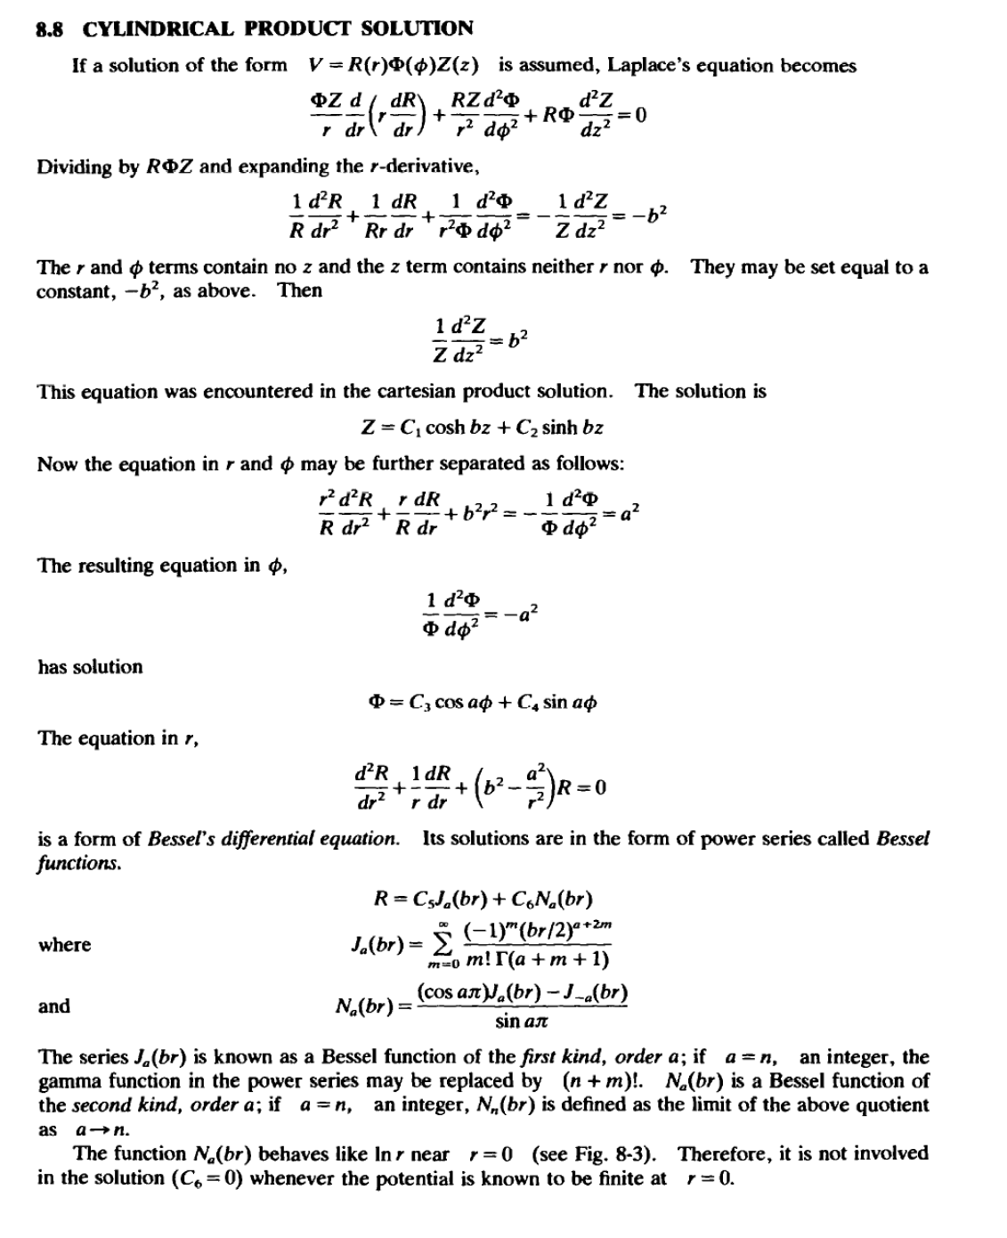
LECTURE EIGHT

